Slide 1
Digital Cookbook &
Recipe Archive Manager
Team Cyan

Slide 2
Application Description
Offline application for managing personal recipes.
Users can create, view, update, and delete recipes.
User-friendly approach to searching and organizing recipes.
Notes:
Personal recipe manager, single user, beginner friendly application that allows the user to manage their recipes in an organized environment. Allows for users to access their recipes offline and stores them in a local relational database. Users won’t have to worry about losing their recipes or finding recipes anymore.

Slide 3
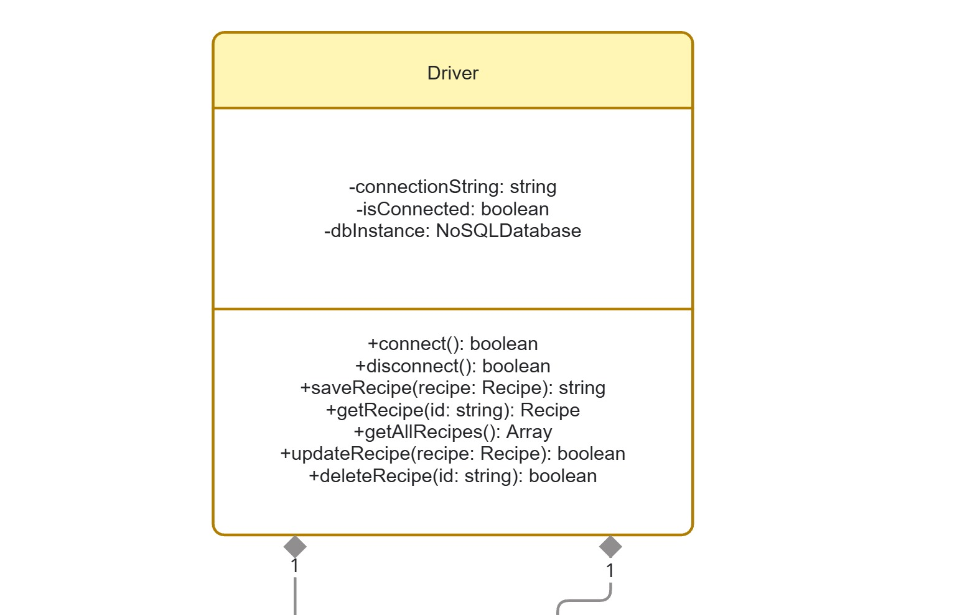

Slide 4
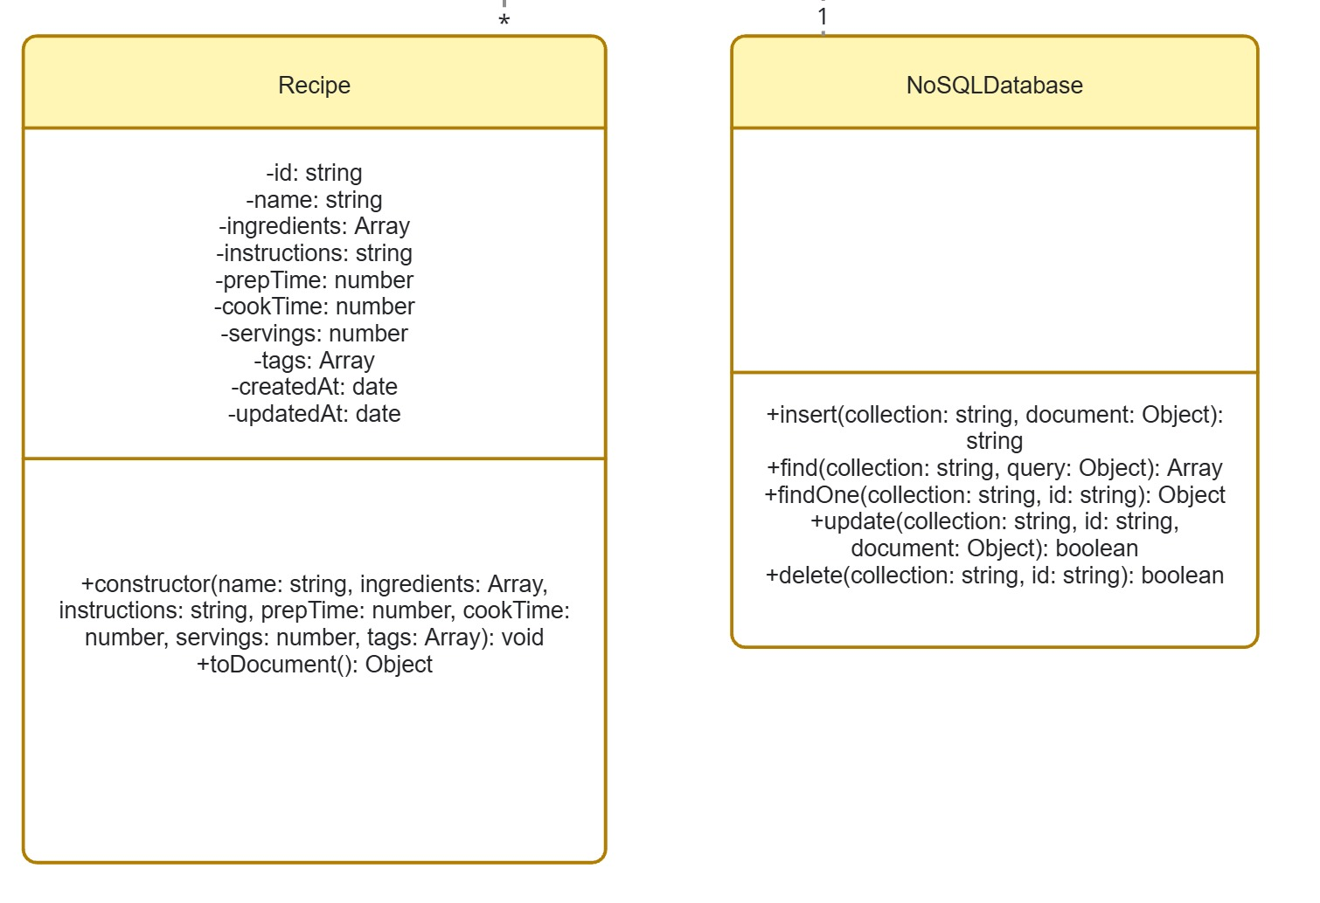

Slide 5
Application Functions
Offline/local access
Import and export recipes
Create and delete recipes
View and update recipe data
Search recipes by name or keywords
Sort and filter recipes based on recipe data and tags
Notes:
Users will be able to create, update, delete recipes easily. Recipes will include a title, description, instructions and list of ingredients with the quantities. Serving sizes will be able to be chosen by the user, and the recipe will adjust to the chosen serving size. The app will also allow for managing ingredients, and their quantity units, as well as possibly offer alternative ingredients in case of allergens. Allergen tracking is also a big feature. Users will have the ability to create allergen labels and filter recipes based on allergens. There will be categories based on cuisines, breakfast vs dinner meals, users will be able to upload nutritional facts and be able to filter recipes based on their goals.

